Slide 1

Team AI Octopi
Notes:
Changes to slides:
- stat slide
Solution benefit slide
“circle” slide with MVP functions on one half and full product (eventual) functions on the other
Change the user journey to a feedback loop

Slide 2










AI Octopi Team Members
Abdullah Asif
Front-End – UI/UX
Student
Olivia Boucher
Team Lead
Student
Geoffrey Clark
Back-End – ML
Deloitte Team Member
Hardik Galiawala
Back-End – ML
Deloitte Team Member
Matt Hughson
Full Stack – Web Developer
Deloitte Team Member
Jonathan Kovacs
Back-End – ML
Deloitte Team Member
Betty Qin
Full Stack – Power BI Expert
Student
Moustafa Shaker
Back-End – Data Science
Student
Rena Yang
Business Solution Architect
Student
Ray Zhou
Front-End
Student

Slide 3


AI Octopi Aims to Mitigate The Gap Between Education and Career
Academic Program Uncertainty
Career Uncertainty
67%
50%
The average number of times people who change jobs
Education
5.7 $×$
2.4 $×$
Percentage of College Students who change their majors at least once
Career
Aged 18 – 24
Aged 25 – 34
Bureau of Labor Statistics (BLS) survey | Indeed
Notes:
A Bureau of Labor Statistics (BLS) survey of people born between 1957 and 1964 that traced their work history through to age 52 shows that people tend to change jobs fewer times as they grow older. From ages 18 to 24, they change jobs an average of 5.7 times. Between 25 and 34 years old, they change jobs an average of 2.4 times. The average goes down again to 2.9 jobs between ages 35 and 44, and then to 1.9 jobs between ages 45 and 52.
Government reports that for every student using financial assistance who delays graduation,
the delay increases their tuition and living expenses loan by $7,300 and decreases their
economic contribution to the local workforce

Slide 4











Using Predictive Modelling to Recommend Custom Education Paths for Users
Problem
Solution
Benefit
Tech Use
Education and job market misalignment
Web-based dashboard
“Best path” recommendation in untapped market
React, PowerBI, and Azur ML Creating “best path” recommendations
Expectations gap
Market/labour insight to empowering users to make smarter edu. investments
20% of Canadians looking to pivot their career through new education
Stats Canada | Stats Canada | Stats Canada | Gov of Canada Job Bank | Universities Canada | Indeed
Notes:
https://www150.statcan.gc.ca/t1/tbl1/en/tv.action?pid=1410002001&pickMembers%5B0%5D=1.1&pickMembers%5B1%5D=2.10&pickMembers%5B2%5D=4.1&pickMembers%5B3%5D=5.2&cubeTimeFrame.startYear=2016&cubeTimeFrame.endYear=2020&referencePeriods=20160101%2C20200101
https://www.univcan.ca/universities/facts-and-stats/
76.0% employment for uni degree → 1.4M ppl at Canadian uni
https://www.insauga.com/many-canadians-planning-to-change-jobs-within-the-next-two-years-survey
32% indended to have new employer
https://www150.statcan.gc.ca/n1/daily-quotidien/200110/cg-a001-eng.htm - 19,132,000
Market info
Uni: 1,064,000
In workforce: 6,122,240
Highschool to uni: 190,000

Slide 5








Evolving Users’ Education and Career Progression Via Product Evolution
Current MVP Features
Future Built-Out Product Features
Education Recommendation
User’s Weighting of Preferences
Skill Improvement
Recommendation
Custom Models for
Edu. Institutions
Geography and Salary
Growth Metrics
User’s Time Horizon

Slide 6



The Users’ Journey Towards Custom Education Recommendations
Next Step Suggestions
8
1
Need Identification
Customer Survey
7
2
Use AI Octopi
AI Octopi Check In
6
Path Recommendation
3
School Recommendation
5
4
Skill Development

Slide 7















Technical Solution - MVP
Data Processing
Machine Learning
Data Visualization
Dashboard (Front-End)
Power BI
Report Server
Data Storage
Extract & Clean Data
Predictive
Model
Notes:
React (time efficient), Azure ML (scalability for dataset size), Power BI (ease of analysis and building out visuals)
Data collected: mock data sets based on what is collectable from resumes (scanned resumes: programs, education). Data of different “piles” for different provinces to reduce bias
R (statistical analysis and data generation, balancing, and cleaning, and team experience) and python (useful for extraction from different data sources)
Front-end tie to back-end = Power Bi
Front-end Tech: Gatsby js (time efficiency), Node js (framework that works with React & Gatsby & team was familiar), React (popular front-end language), Webpack, Javascript, html., CSS, → use logos
Risk & Mit
Mitigate bias:
Training model using data that is relevant to ppl using the service in the area and group
Not using any attributes in resume or datasets that create bias (gender, income, country of origin, etc)
Scalability
Talk about the data sets we’re using & how they’re scalable

Slide 8



Technical Solution - Full Product
Data Processing
Machine Learning
Data Visualization
Dashboard (Front-End)
Data Storage
Extract & Clean Data
Mobile App
Predictive
Model
Notes:
MVP vs Full product
Data (Data parameter: sources, Mock)
Feature extraction
ML algorithm
Predictive Model
Front-end tie to back-end = Power Bi
Front-end Tech: Gatsby js (time efficiency), Node js (framework that works with React & Gatsby & team was familiar), React (popular front-end language), Webpack, Javascript, html., CSS, → use logos
Risk & Mit
Mitigate bias:
Training model using data that is relevant to ppl using the service in the area and group
Not using any attributes in resume or datasets that create bias (gender, income, country of origin, etc)
Scalability
Talk about the data sets we’re using & how they’re scalable

Slide 9





















Partner and Revenue Structure
Partnership
Certificate Programs
Collect massive data
Mitigate dataset bias
Customized Solutions: Baseline Subscription
Employment platforms
Job listing platforms
Headhunters to gain credibility
Educational Institutions
Subscription fee based on level of customization
Pay as you use for credits
Individual Users
Users can get credits for social media sharing
High School Students
College Students
Professionals
Notes:
Storyline idea: having all the value chain touch points throughout the product’s touch points for individual’s job progression → I think the circles need to be inverted to show this (red circle at top, then orange, then yellow)
Revenue model: base annaul subscription (based on the need of subscription) + charge on a per use basis
“tiers” of subscription base fee based on customization level
Pay as you use: users can redeem credits when they use certain amount of times

Slide 10

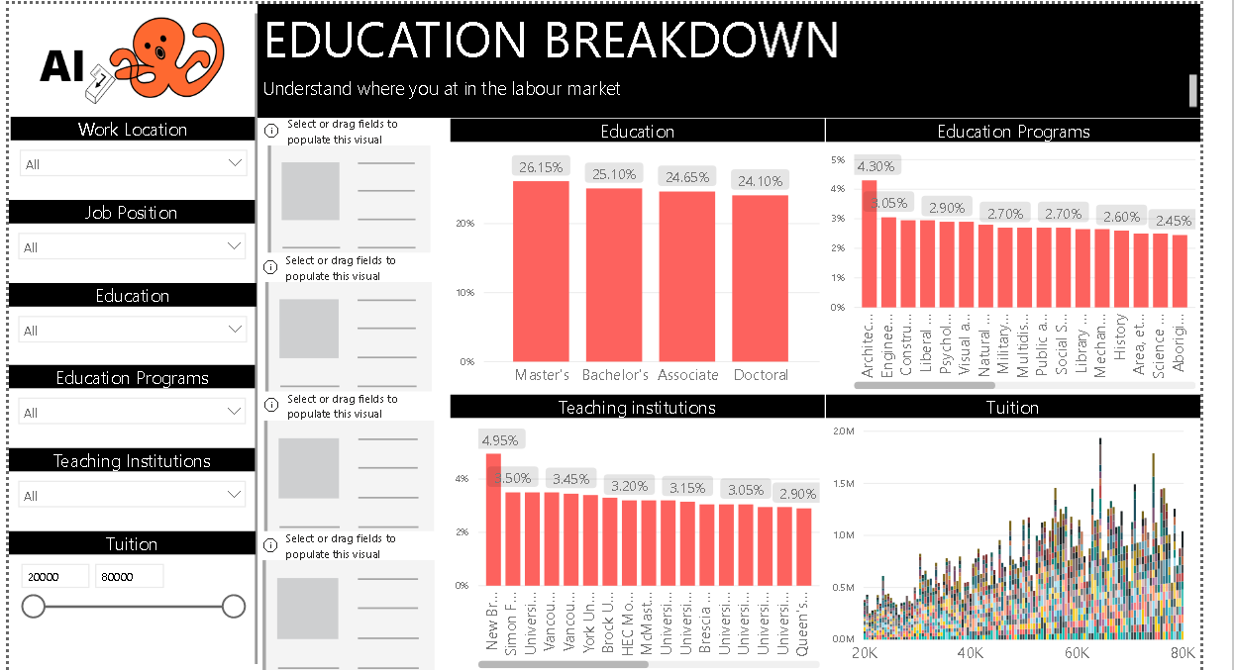
AI Octopi “Best Path” Recommendation In Action

